Slide 1
Sync timing between RT OS and automotive ethernet card
Tianpei Lei
Software Engineer

Slide 2
Agenda
Background
Introduction to linuxptp
Implementation
Validation Result

Slide 3
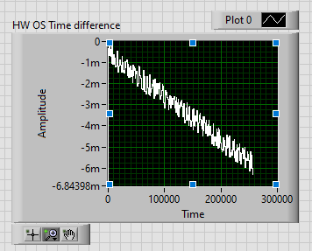
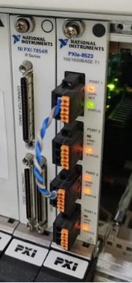
Background
Motivation
An increasing drift between RT OS time and automotive ethernet card time (about 15 milliseconds every 10 minutes) will emerge if there is no synchronization.
Port ENET1 on the PXIe-8523 is the master port, ENET 3 is the slave port, they are connected through a cable. When ENET 3 receives a frame from ENET 1, a timestamp will be generated. Every time the RT OS read a frame from ENET 3, the timestamp will be compared to current system time (measuring time drift).
We want to synchronize the RT OS time to the automotive ethernet card (PXIe-8523) time.
As Paul Birkholz mentioned in the e-mail with Stefano, with the help of the config-file provided by him and Precision Time Protocol (PTP), we can synchronize the time using PXIe-8523 under 802.1AS instead of PXIe-6683 under IEEE-1588.
ENET1
ENET3

Slide 4
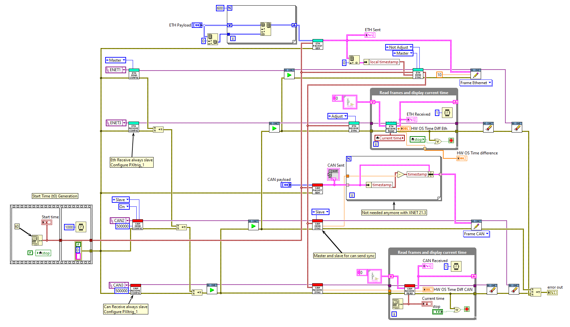
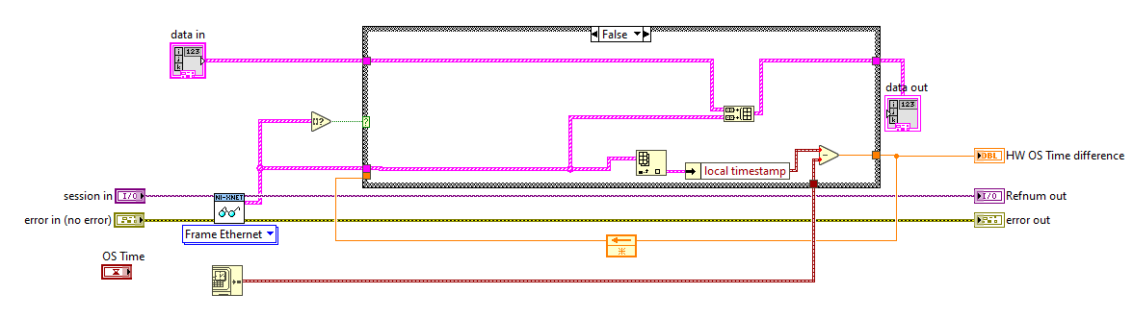
Background
main-eth-master.vi
Time Drift

Slide 5
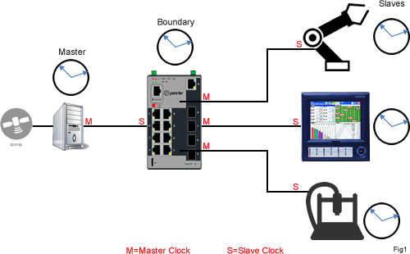
Introduction to linuxptp
The Structure of PTP (Precision Time Protocol )
The clocks managed by PTP follow a master-slave hierarchy. The slaves are synchronized to their masters.
The top-level master is called the grandmaster clock. The grandmaster clock can be synchronized with a Global Positioning System (GPS).
The master-slave hierarchy is updated by the best master clock algorithm (BMCA) , which runs on every clock (to define the grandmaster clock).
The clock with only one port can be either master or slave. Such a clock is called an ordinary clock (OC).
A clock with multiple ports can be master on one port and slave on another. Such a clock is called a boundary clock (BC).

Slide 6
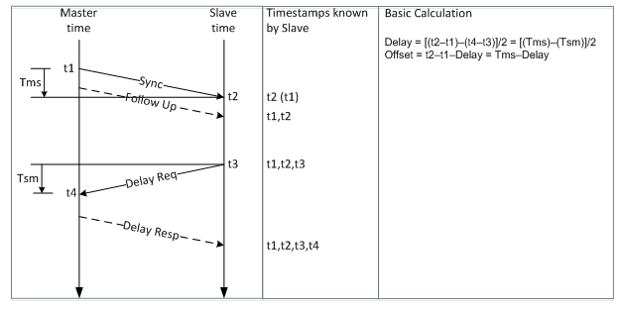
Introduction to linuxptp
What is linuxptp?
The implementation of PTP is provided by the linuxptp package.
linuxptp package includes the ptp4l and phc2sys programs for clock synchronization.
ptp4l implements the PTP boundary clock and ordinary clock. When hardware time stamping is enabled, ptp4l synchronizes the PTP hardware clock to the master clock. With software time stamping, it synchronizes the system clock to the master clock.
phc2sys is needed only with hardware time stamping to synchronize the system clock to the PTP hardware clock on the network interface card (NIC).

Slide 7
Introduction to linuxptp
What's the Difference Between TSN (802.1AS) and IEEE-1588?
TSN is a timing and synchronization standard built on the Ethernet standard that uses a profile of IEEE-1588 hardware synchronization. TSN requires the same hardware consideration for controllers as 1588 hardware timed sync in that it needs a direct connection from the NIC to the timing source.
TSN differs from 1588 hardware in that TSN networks will generate an error if synchronization falls out of expected bounds, unlike 1588 hardware sync, and that TSN timing packets have priority scheduling. Having priority means that TSN timing packets will be sent out from the grandmaster and from TSN enabled switching devices without latency as they will not have to wait for other packets in the buffer to be sent. This guarantees tight synchronization regardless of the amount of network traffic.
https://knowledge.ni.com/KnowledgeArticleDetails?id=kA00Z0000019V0iSAE&l=zh-CN

Slide 8
Implementation
Outline
Using Ethernet Time Sync Protocol (Advanced).vi to define ENET1 as the grandmaster clock.
Using ptp4l command to define ENET3 as the slave clock of ENET1 and synchronize ENET3 to ENET1.
Using phc2sys command to define RT OS time as the slave clock of ENET3 and synchronize RT OS time to ENET3.
ENET1
ENET3
OS Time

Slide 9
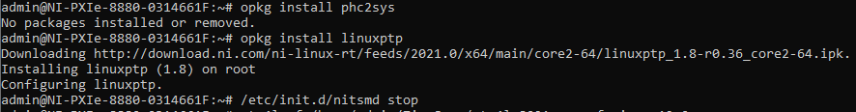

Implementation
Preparation
Install linuxptp via following commands:
- opkg update
- opkg install phc2sys
- opkg install linuxptp
- /etc/init.d/nitsmd stop (only necessary if NI-Sync is installed on the target)
Transport the ‘ptp4l_8021as.conf’ provided by Paul to specific location in RT system: e.g. /home/admin/SynchronizeSystemTime/
Install NI-MAX and find the PXIe-8523 under Remote Systems.

Slide 10
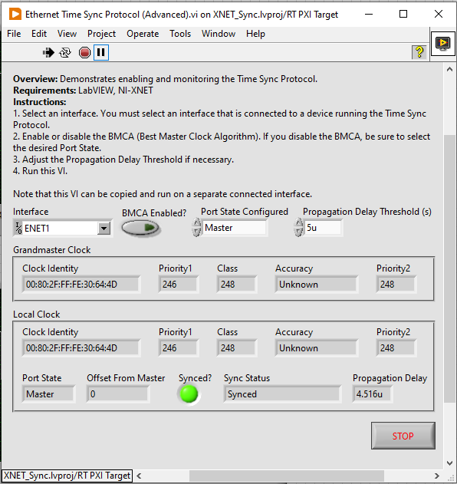
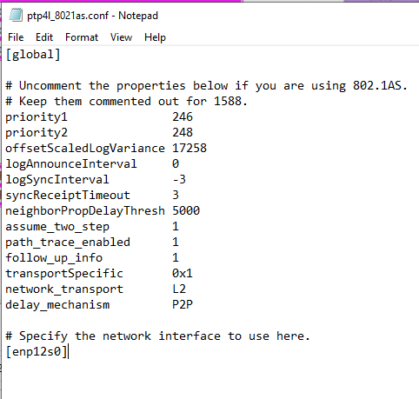
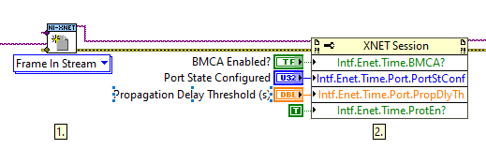
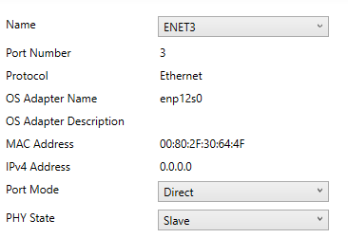
Implementation
VI settings & Configuration file: Defining The Grandmaster Clock
NI-MAX

Slide 11
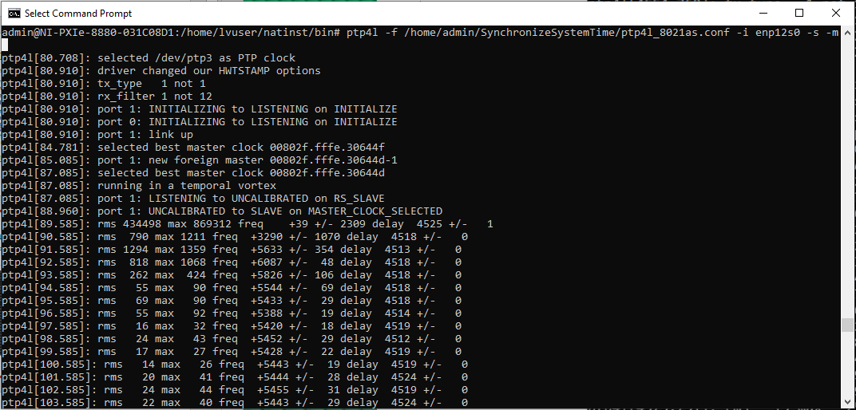
Implementation
Ptp4l: Synchronizing the PHC (PTP Hardware Clock)
https://linux.die.net/man/8/ptp4l Options for ptp4l
-f: Read configuration from the specified file.
-i: Specify a PTP port, it may be used multiple times. At least one port must be specified by this option or in the configuration file.
-s: Enable the slaveOnly mode.
-m: Print the log

Slide 12
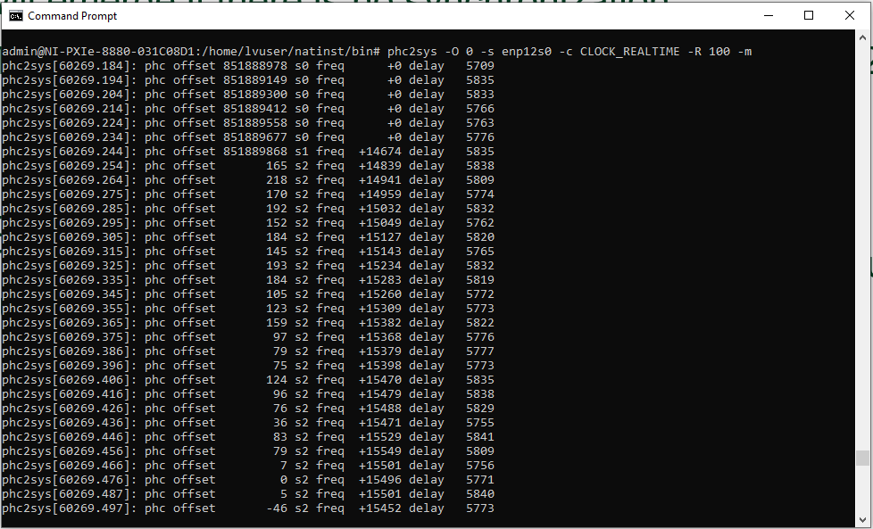
Implementation
Phc2sys: Synchronizing the System Clock
https://linux.die.net/man/8/phc2sys Options for phc2sys
-O: Specify the offset between the slave and master times in seconds. The default is 0 seconds.
-s: Specify the master clock by device (e.g. /dev/ptp0) or name (e.g. CLOCK_REALTIME for the system clock).
-c: Specify the slave clock by device (e.g. /dev/ptp1) or name. The default is CLOCK_REALTIME (the system clock).
-R: Specify the slave clock update rate when running in the direct synchronization mode. The default is 1 per second.

Slide 13
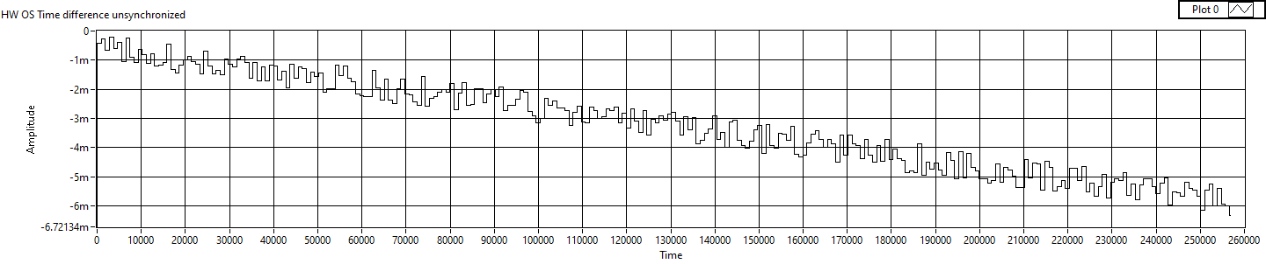
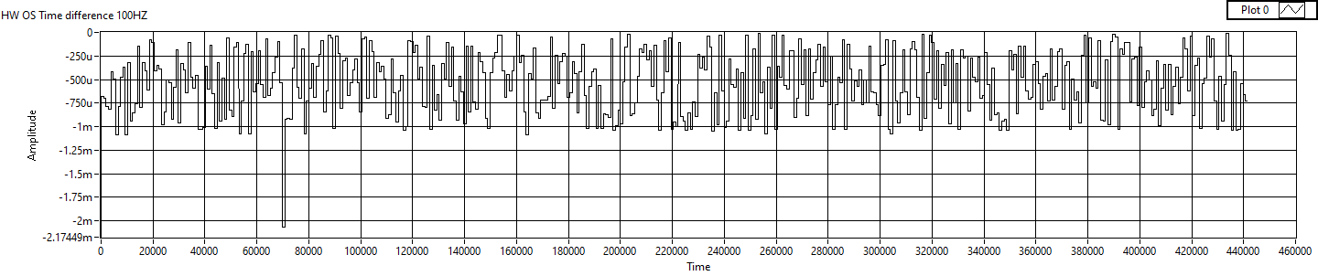
Validation Result
Drift between RT OS Time and Hardware Time:
Time drift before synchronization
Time drift after synchronization with update rate of 100HZ

Slide 14
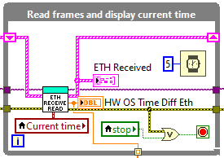
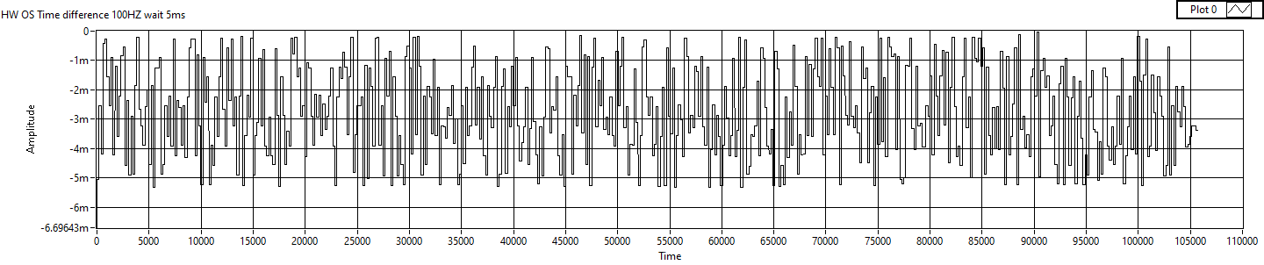
Validation Result
Drift with Different Loop Wait Time:
Update rate 100HZ, Read-Loop wait time 5ms

Slide 15
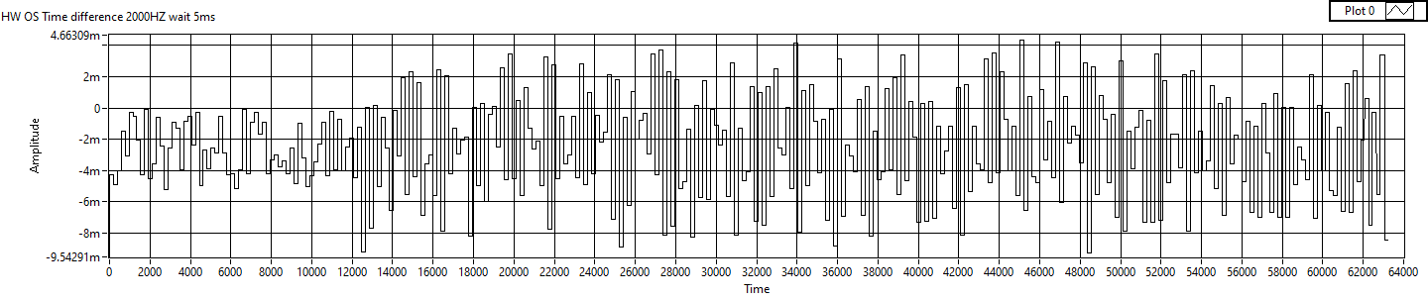
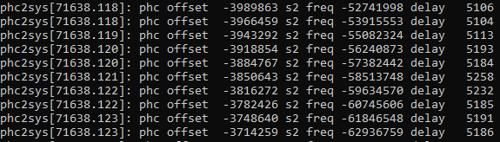
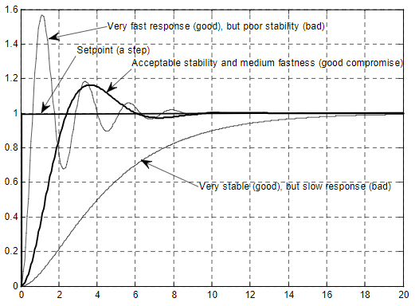
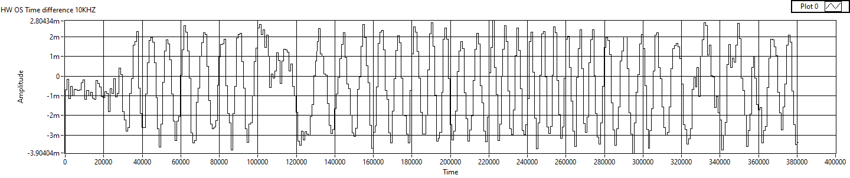
Validation Result
Extra Findings: Update Rate Too Large
Update rate 2000HZ
Overshoot
Update rate 10000HZ

Slide 16
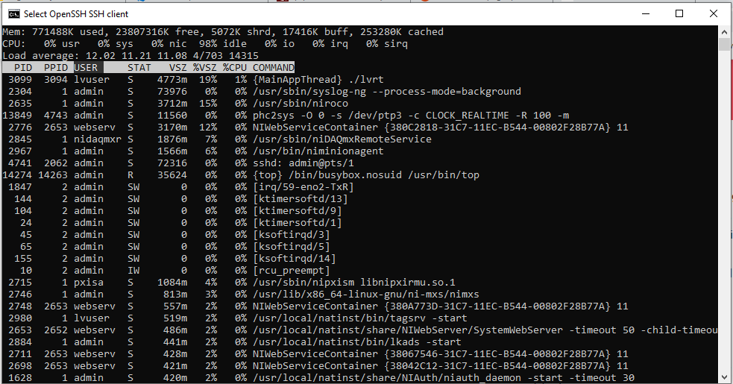
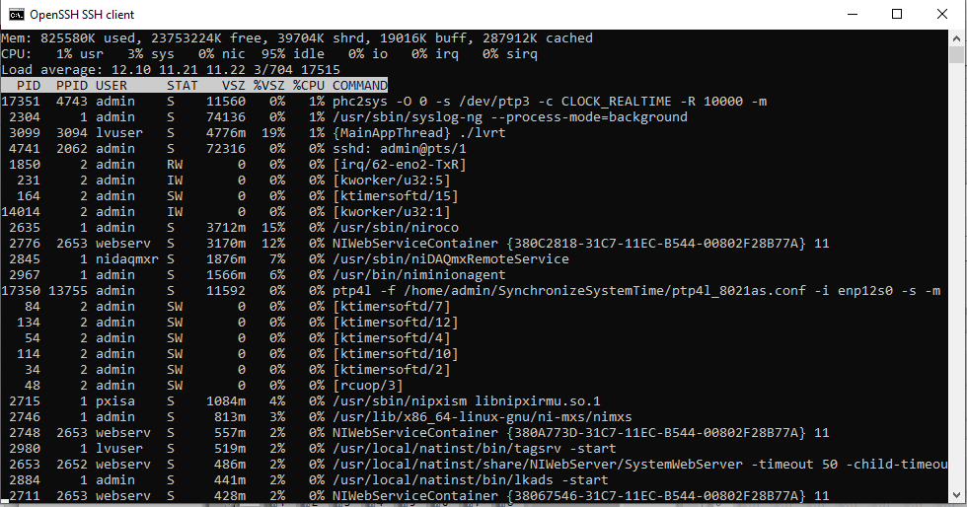
Validation Result
CPU Usage with Different Update Rate:
100HZ
10KHZ

Slide 17
Validation Result
Conclusion
The synchronization is successful, the final jitter is about 100~200 microseconds and time drift is not increasing.
Time drift between RT OS time and hardware time depends on read-loop wait time (major factor), update rate and other parameters which affect the negative feedback.
The CPU usage of time synchronization is neglectable.

Slide 18
THANK YOU

